Slide 1
Lecture 3

Slide 2
The (b-1)’s complement
Given a positive number N in base b with the integral part of n digits and the fractional part of m digits, the (b-1)’s complement of N is defined
(b^{n} - b^{-m} ) – N

Slide 3
Ex. find the 9’s complement of (52520)₁₀
N = 52520, b = 10, n = 5,
m = 0 // number of fractional part digits
(b^{n} – b^{-m}) – N = (10⁵ – 10⁻⁰) – 52520
= (100,000 – 1) – 52520 = (47479)₁₀
Ex. find the 9’s complement of (0.3267)₁₀
N = 0.3267, b = 10, n = 0, m = 4
(b^{n} – b^{-m}) – N = (10⁰ – 10⁻⁴) – 0.3267
= (1 – 0.0001) – 0.3267 = (0.6732)₁₀
Ex. find the 9’s complement of (25.639)₁₀
N = 25.639, b = 10, n = 2, m = 3
(b^{n} – b^{-m}) – N = (10² – 10⁻³) – 25.639
= (100 – 0.001) – 25.639 = (74.36)₁₀

Slide 4
Ex. find the 1’s complement of (101100)₂
N = 101100, b = 2, n = 6, m = 0
( b^{n} – b^{-m}) – N = (2⁶ – 2⁻⁰)₁₀ – (101100)₂
= (63)₁₀ – (101100)₂ = 111111 – 101100
OR
= (1000000 – 1) – 101100 = (010011)₂
Or simply flip 1’s to 0’s and 0’s to 1’s → 101100 = 010011
Ex. find the 1’s complement of (0.0110)₂
N = 0.0110, b = 2, n = 0, m = -4
(b^{n} – b^{-m}) – N = (2⁰ – 2⁻⁴)₁₀ – (0.0110)₂
= (1 – 0.0001) – 0.0110 = 0.1111 – 0.0110
= (0.1001)₂

Slide 5
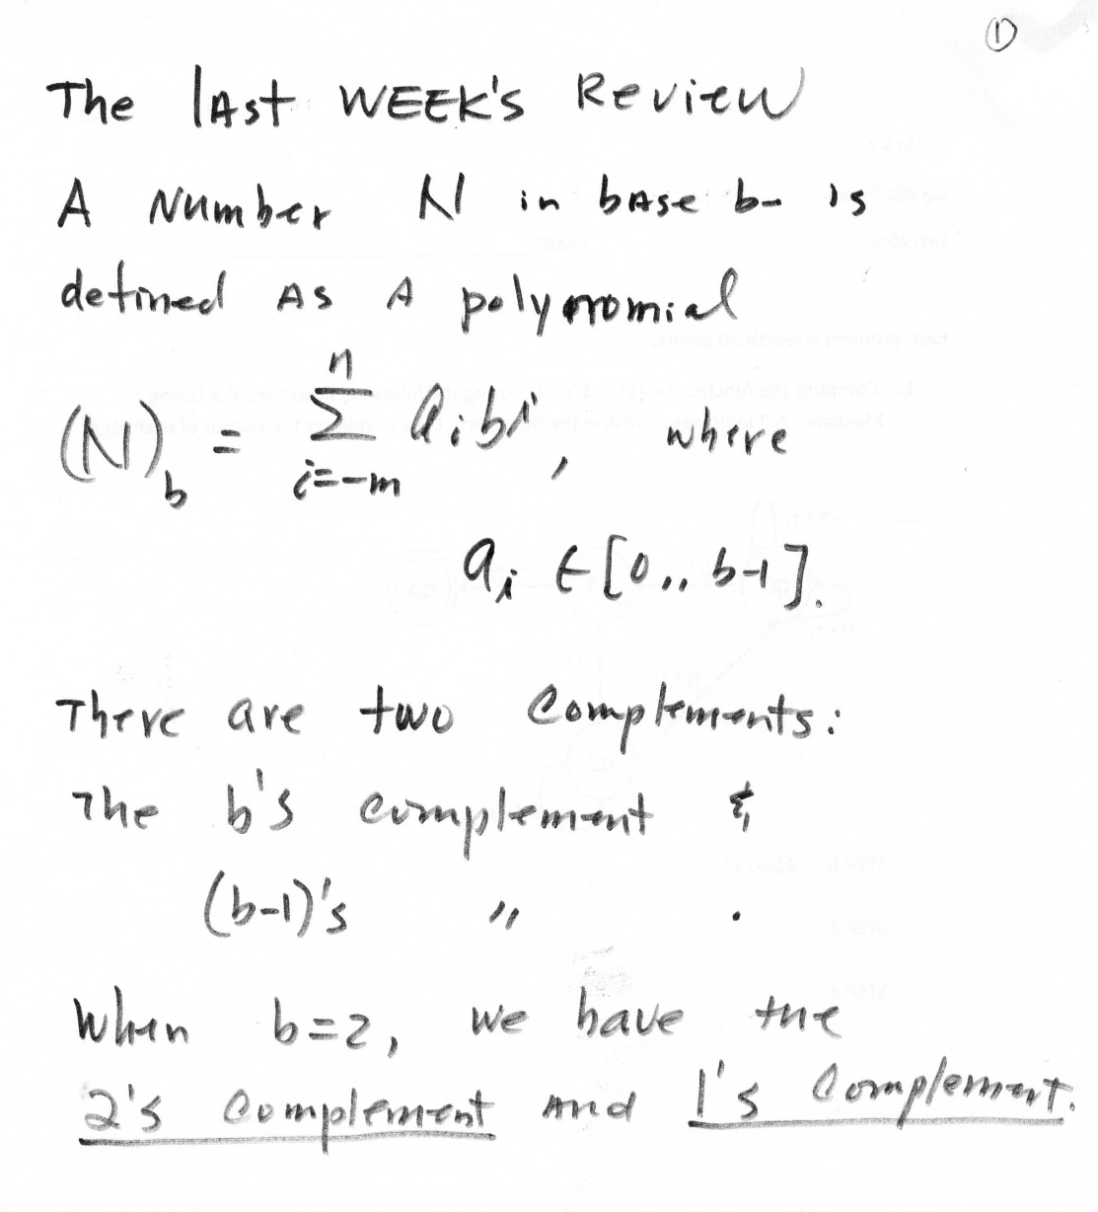
The Review from the last week

Slide 6
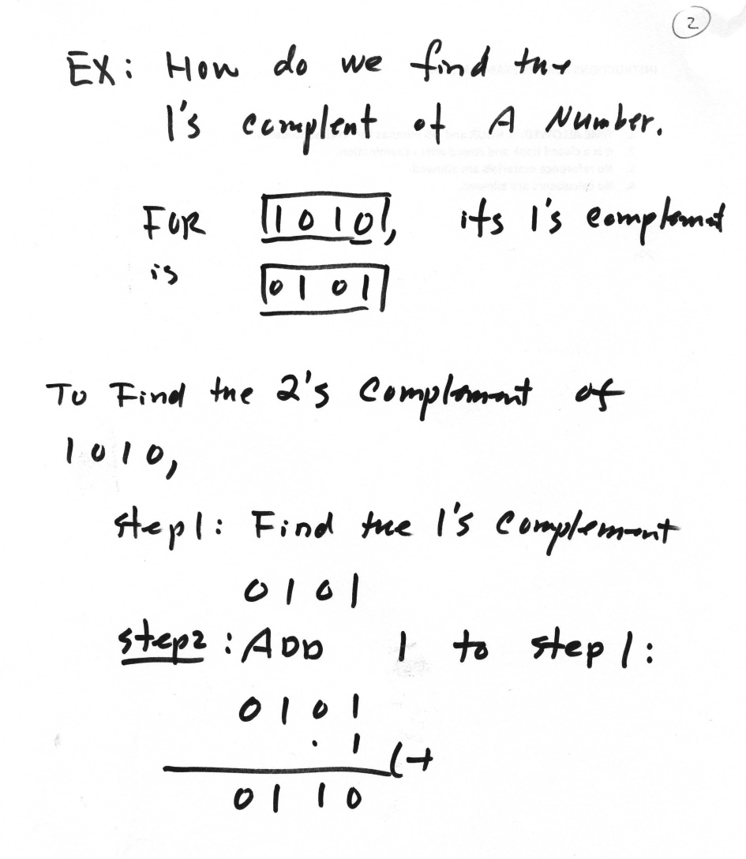
A quick & easy way to compute 1’s complement and 2’s complement

Slide 7
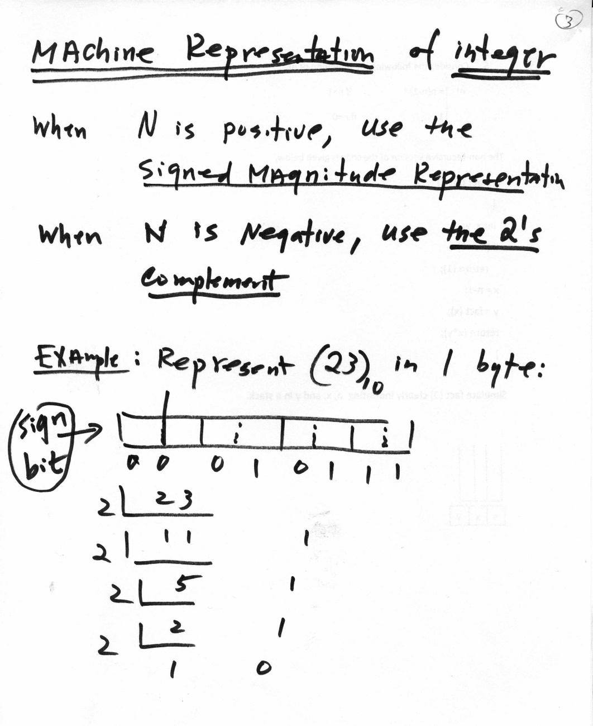
Machine Representation of an Integer

Slide 8
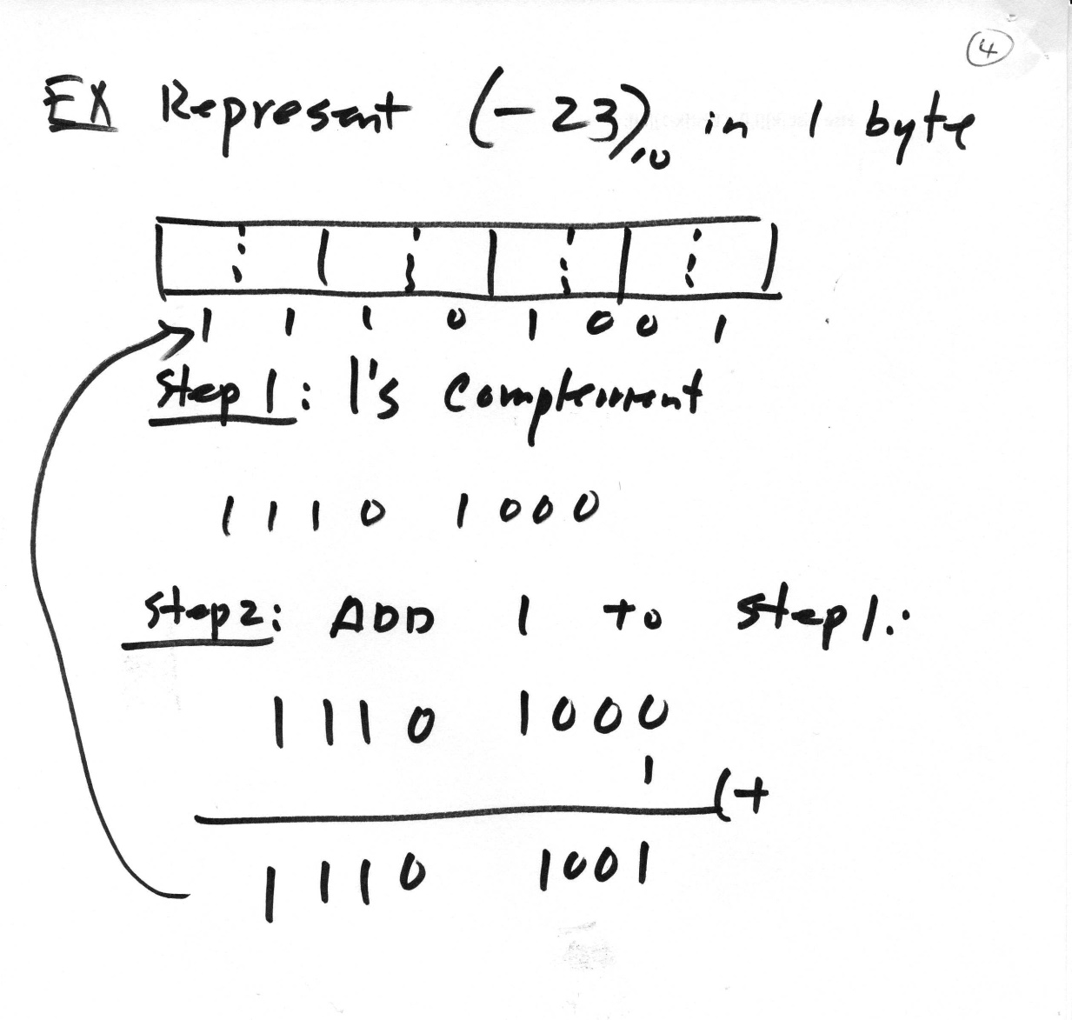
Negative Integers

Slide 9
Machine Representation of Integers
Positive integer = Signed Magnitude Representation
Negative integer = 2’s Complement Form
byte = 1 byte
word = 2 byte
dword = 4 byte
Ex. Represent (+23)₁₀ in 1 byte
Ex. Represent (-23)₁₀ in 1 byte
An overflow occurs when carry- in != carry out
ex.
carry-out carry- in
0 | 0 | 0 | 1 | 0 | 1 | 1 | 1
1 | 0 | 0 | 1 | 0 | 1 | 1 | 1

Slide 10
Ex. 4 bit integers ???????????
4 0 1 0 0 -4 1 1 0 0
5 0 1 0 1 -3 1 0 1 1
-1 1 0 0 1 +7 0 1 1 1
Carry- in = 1 Carry- in = 0
Carr- out = 0 Carry- out = 1
Then, overflow Then, overflow
-7 1 1 1 1
-6 1 1 1 0
1 1 0 1
Carry- in = 1
Carry- out = 1
Then, no overflow exist.
Arithmetic overflow simply means that the sign bit digit changes between the original and result which gives a different number if treated as a sign bit.

